Slide 1
Stack Overflow
Imbalance Programmer’s world

Slide 2
Stack Overflow – Programmer’s social network
Stack Overflow is a question and answer site for programmers
It started from 2008
More than 10m registered users, more than 16m questions every year.
Keep growing

Slide 3
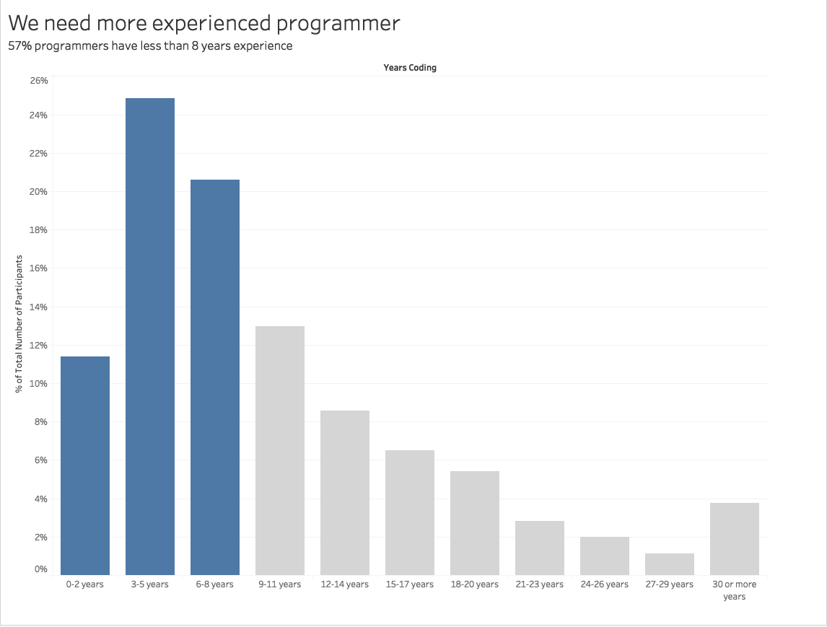
Imbalance Programmer World - Experience

Slide 4
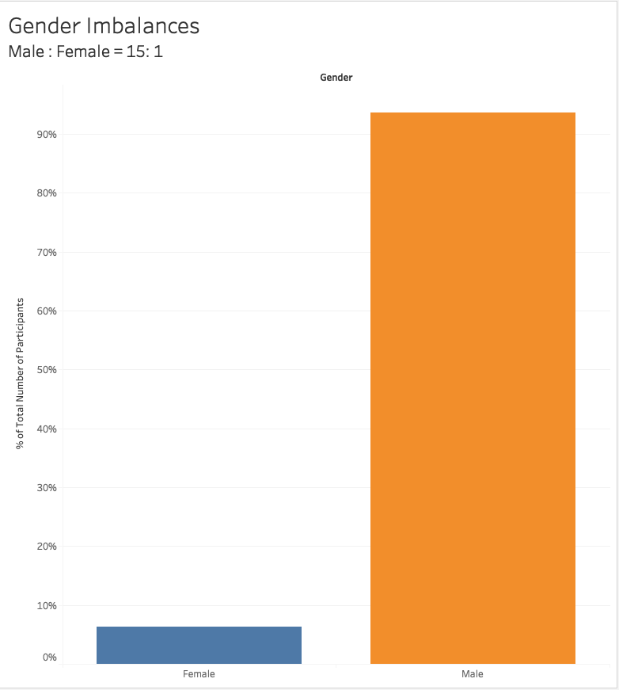
Imbalance Programmer World - Gender

Slide 5
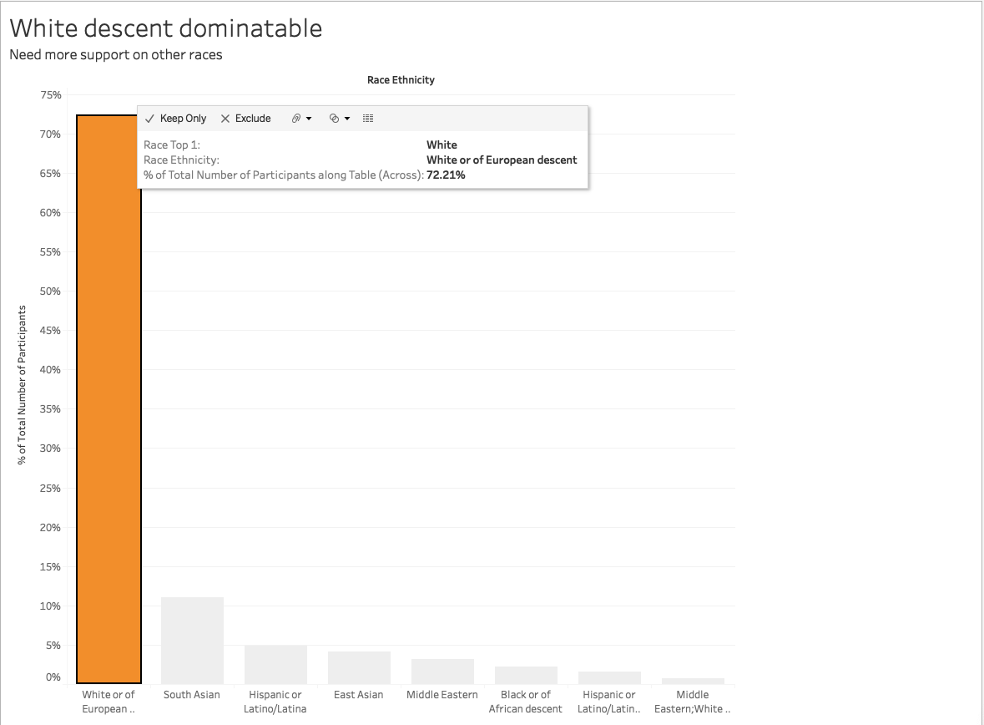
Imbalance Programmer World - Race

Slide 6
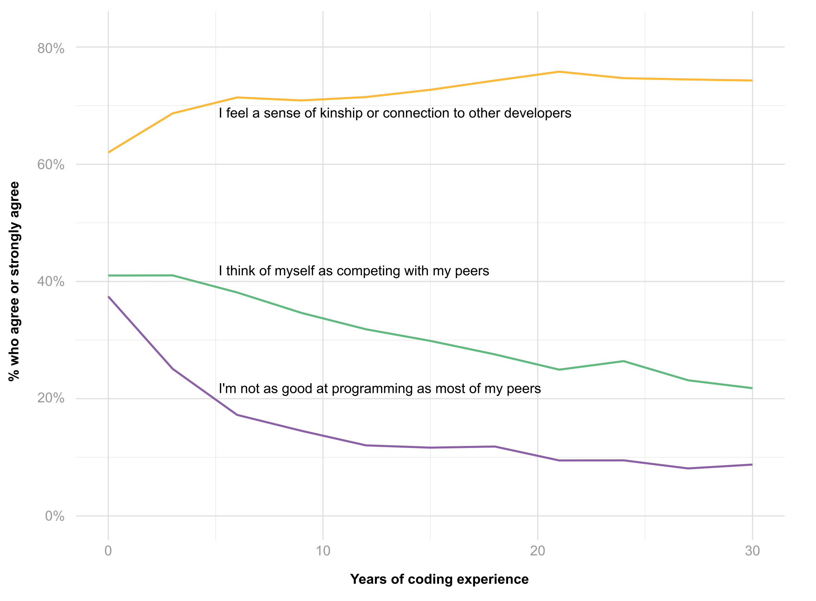
Morale

Slide 7
Conclusions
A lot of imbalance in programmer world
We need the community to support more
Female programmers
More experience programmers
Diversity on race
We need create more training to let programmer be more confident.

